Slide 1

NYC Bike Routes
By Sizhe Pei
sp7398@nyu.edu

Slide 2
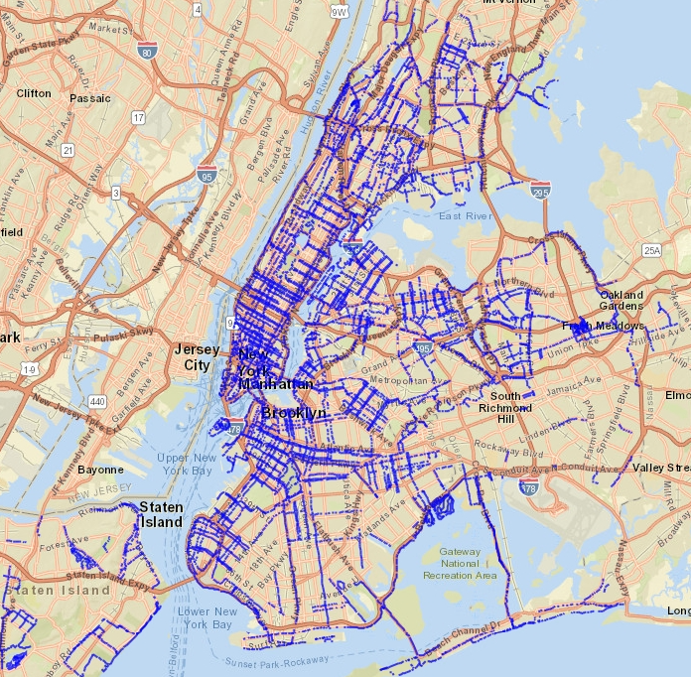
Distribution of routes
Length and density of routes in each neighborhood
Classify the neighborhoods by the features of routes
Notes:
The goal of the project is to display the distribution of routes from 2017 to 2022, then calculate the length of routes and density in each neighborhood.
After that, I will classify the neighborhoods by the features of routes

Slide 3
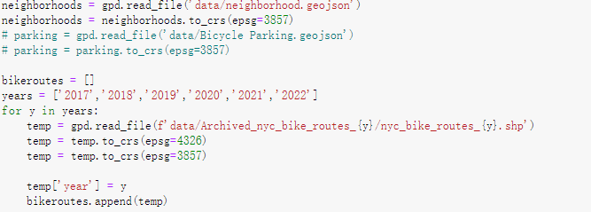
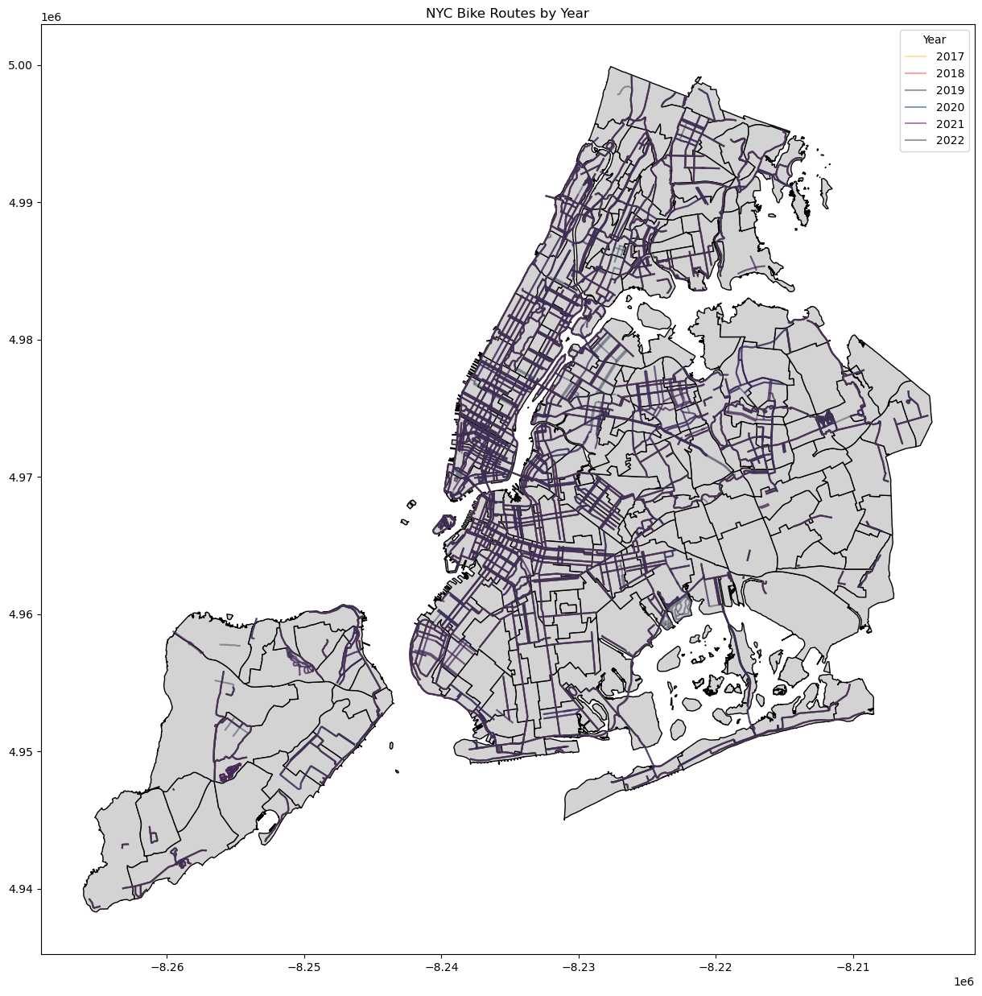
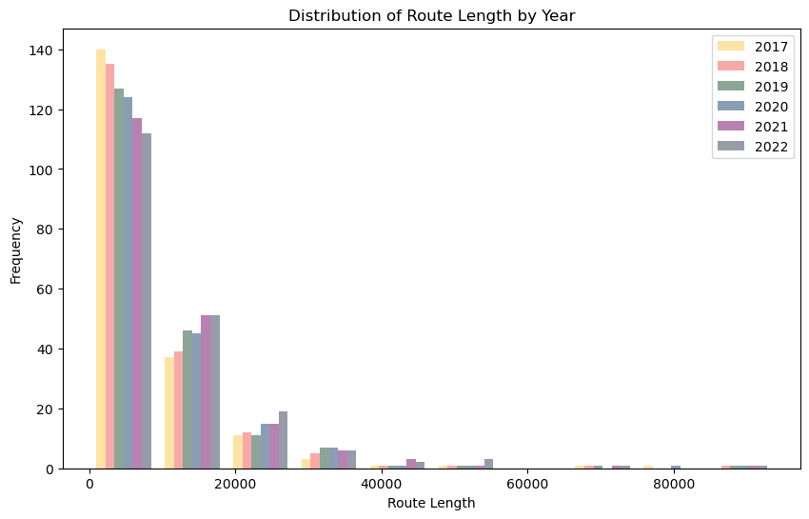
Route length statistics
Notes:
Left: all routes of the six years,
Most routes exist from 2017
Code: change the geo data type, then the length function will return result in meters, otherwise the unit is degree
Right: length statistics,
Most are less than 20 kilometers of each neighborhood

Slide 4
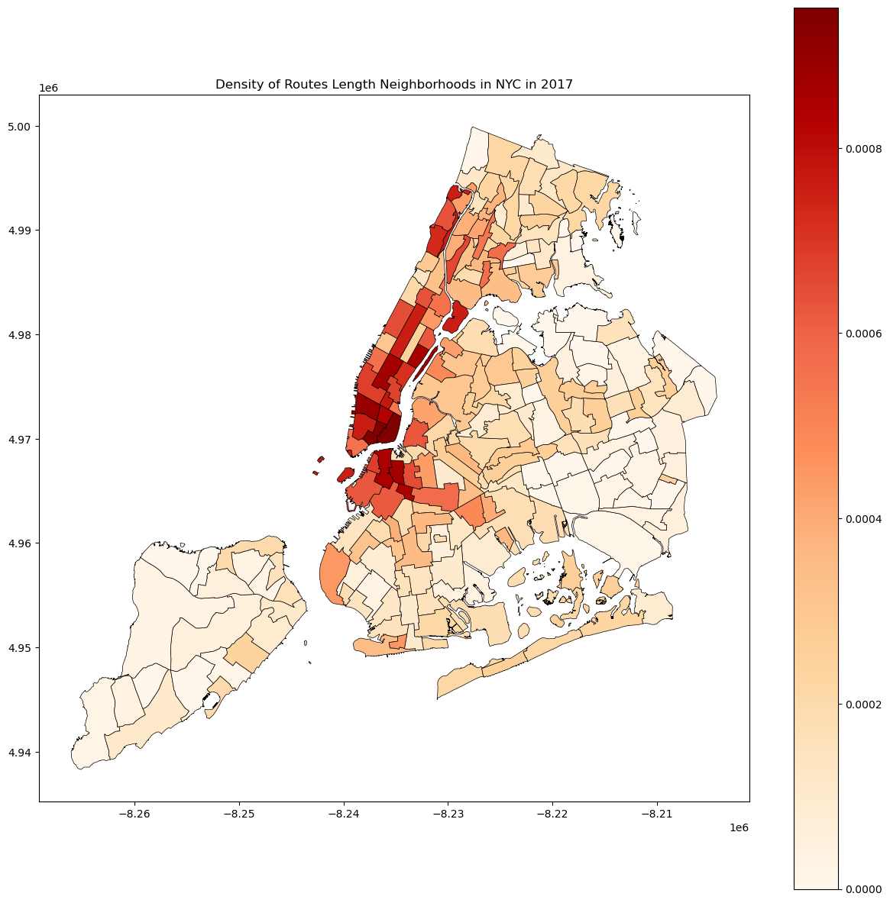
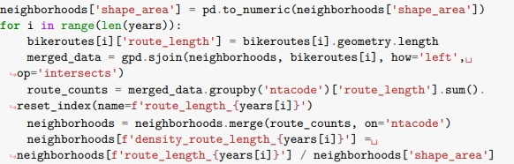
Calculate the route length by geometry
Count the length through the groupby method
Sum of the routes in the same area
Merge the data into neighborhoods, then calculate density of routes in each neighborhood by the shape_area
Density distribution by neighborhood

Slide 5
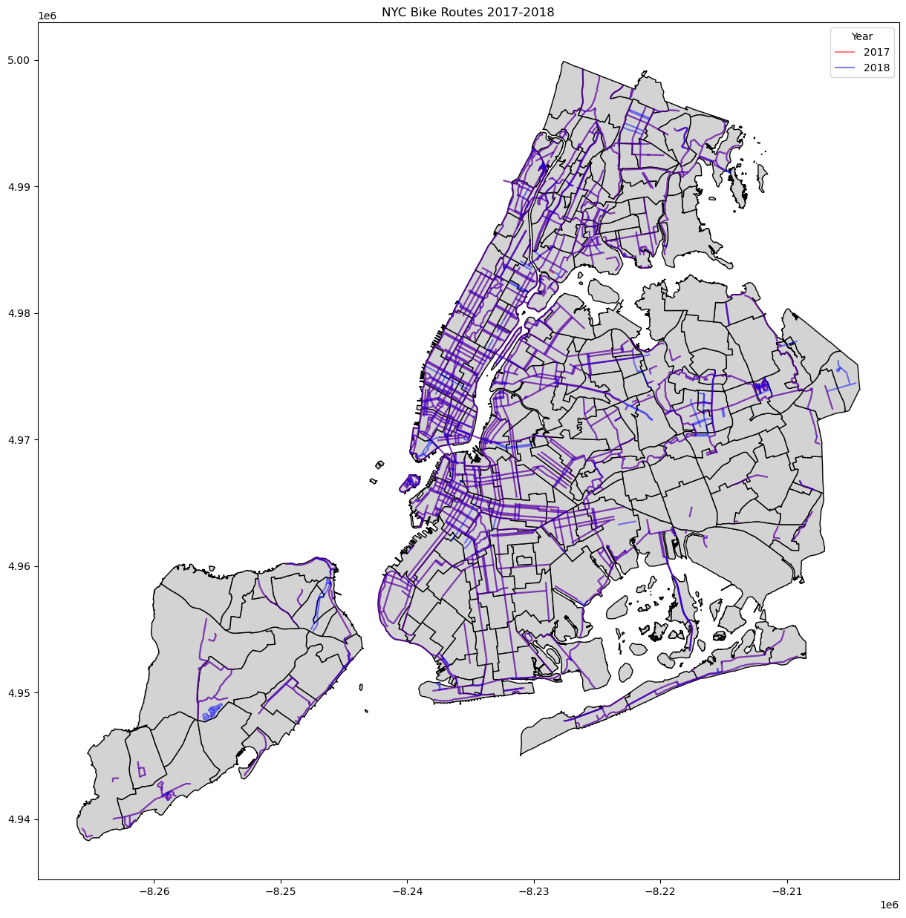
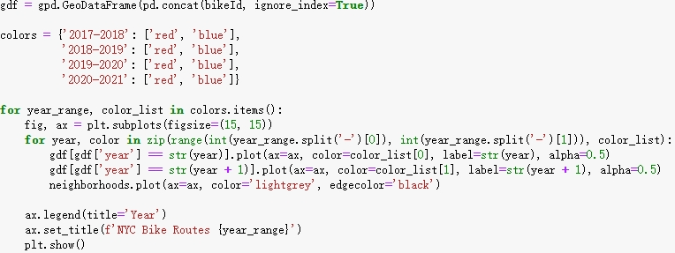
Display of change of each two years
colors as color map
Assign different colors to two-year routes
1.
Example of 2017 and 2018

Slide 6
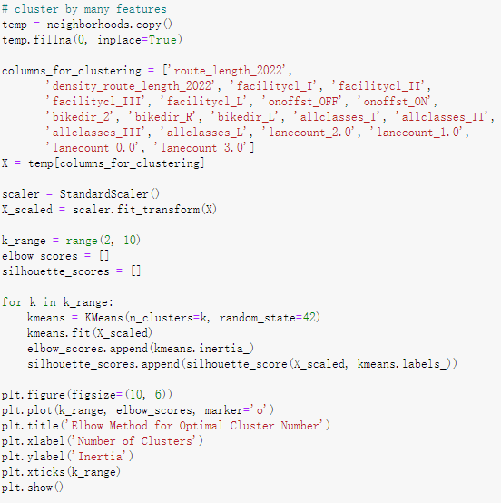
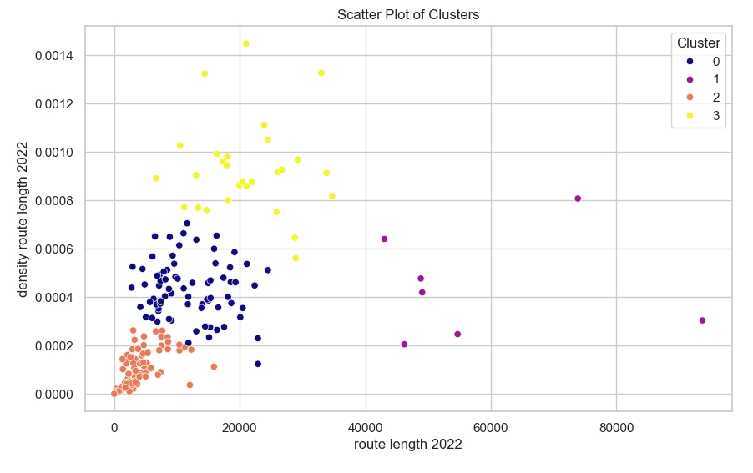
1.
Clustering at neighborhoods level
Count each feature
Standardize data
Elbow Method to search the suitable cluster
Test again with two features, length and density:
0: medium length and medium density
1: long length but medium density
2: short length and low density
3: long length and high density
Notes:
Left code: many features: classes, facilities, on/off street, direction and width
Right, clustering by length and desntiy

Slide 7
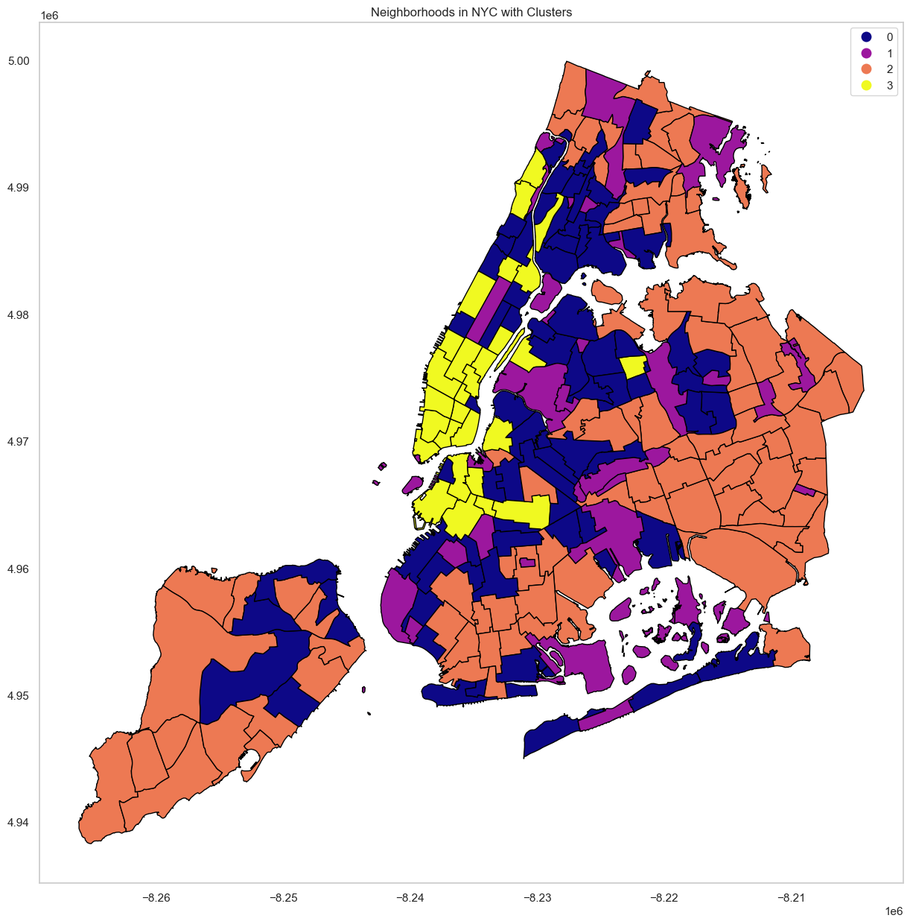
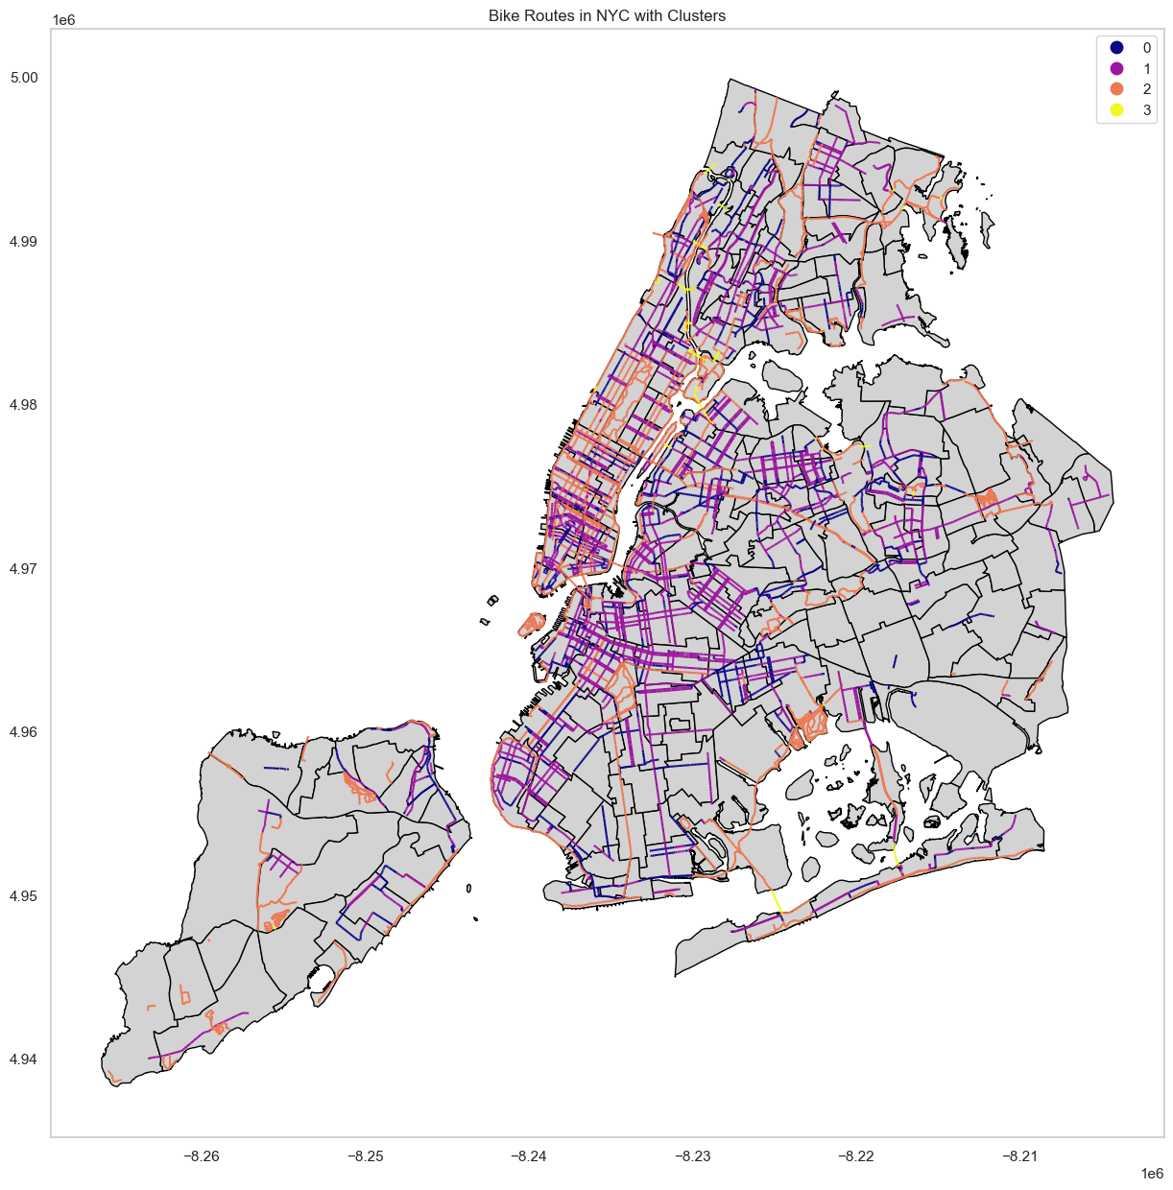
Cluster of neighborhoods
Cluster of routes

